Slide 1
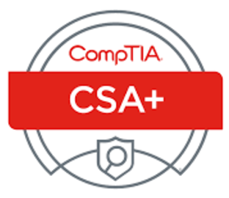
CSA+, CAE2Y, & Apprenticeships
Professor Steve Linthicum, CISSP, VCP, MCSE Deputy Sector Navigator, ICT/DM Doing What Matters for Jobs and the Economy

Slide 2
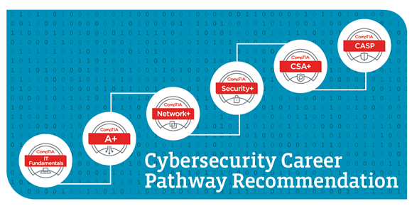
Why All Three are Connected
Coastline Apprenticeship Program
California Common Course Identifiers
CAE2Y

Slide 3
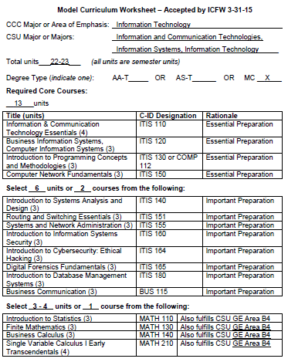
California Common Course Identifiers www.c-id.net
Course Portability Between Community Colleges
Potential Uniformity – Associate Transfer Degrees (ATD)
A+
Network+
Server+
Security+

Slide 4
Center of Academic Excellence–2 Year DHS/NSA CAE2Y Designation
Institutional Designation
Instruction Aligned with Knowledge Units
Program Qualifications
Scripting
Network+
Server+
Security+

Slide 5
Coastline Cybersecurity Apprenticeship Program
$1,000,000 Grant Funded by CCCCO
Program Registered with DAS
2000+ Hours of “Earn & Learn
Seven (7) Academic Courses
Scripting
Network+
Server+
Security+

Slide 6
What About CSA+ ?
Seventh (7) Academic Course
Planned Addition to Model Curriculum (Fall 2017)
Capstone Course for CCAP
Scripting
Network+
Server+
Security+

Slide 7
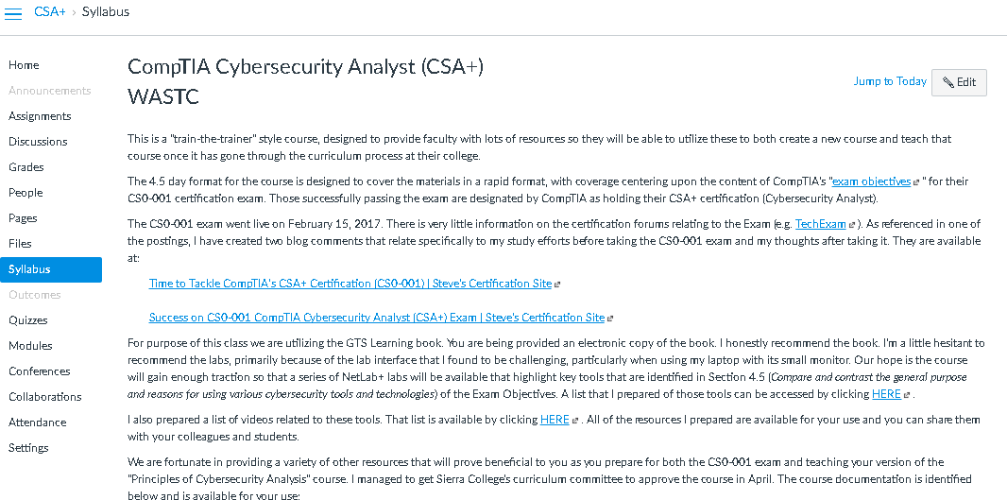
CAP Resources
http://bit.ly/CSAplus

Slide 8
Questions

