Slide 2
Securing the Academy: Better Cybersecurity for Instructors and Administrators

Slide 3
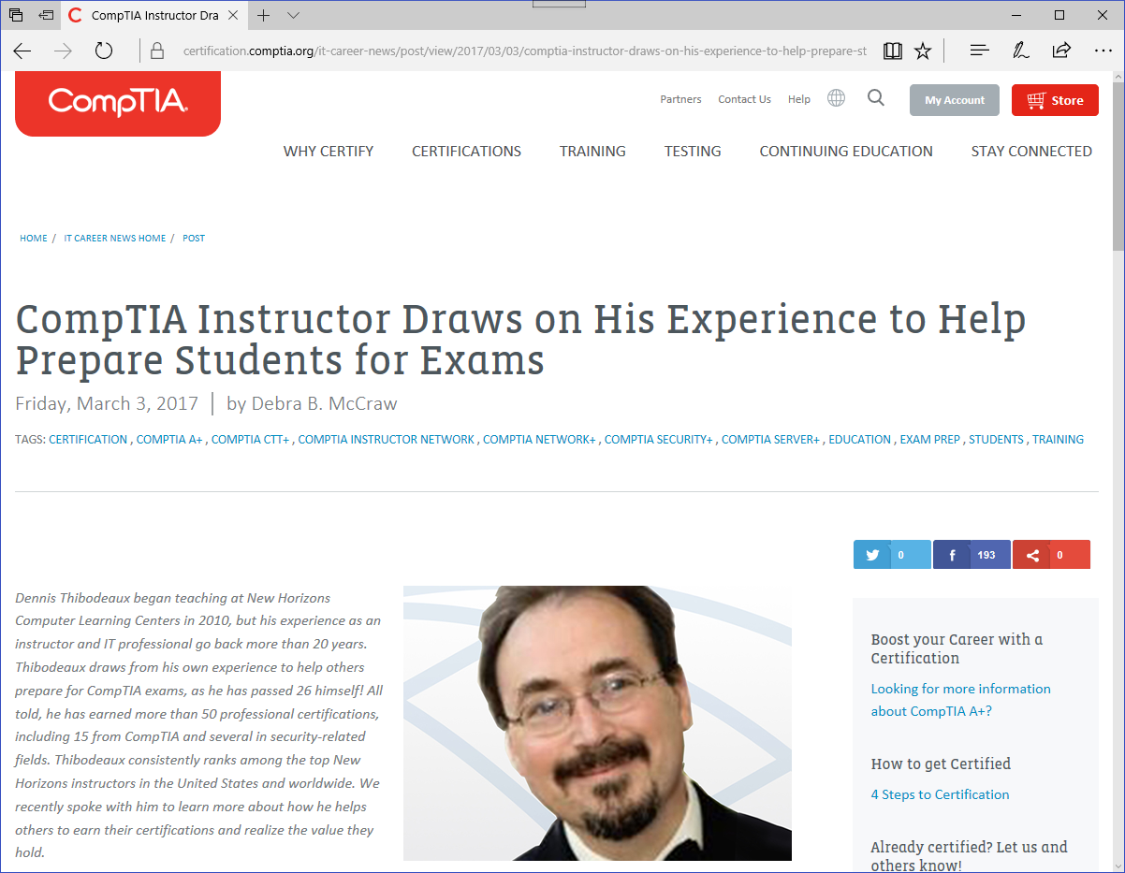
PRESENTER: Dennis Thibodeaux, CISSP
Global Top 25 Technical Instructor at New Horizons Computer Learning Centers
Certified Fraud Examiner, IT pro, and information security specialist with a professional focus on incident response and investigations
CompTIA Security+, CSA+, CASP, Linux+, Project+, Server+, Cloud+, Network+, A+, Mobility+, CDIA, etc. (15 CompTIA certifications – and counting…)

Slide 4
It’s getting rough out there…

Slide 5
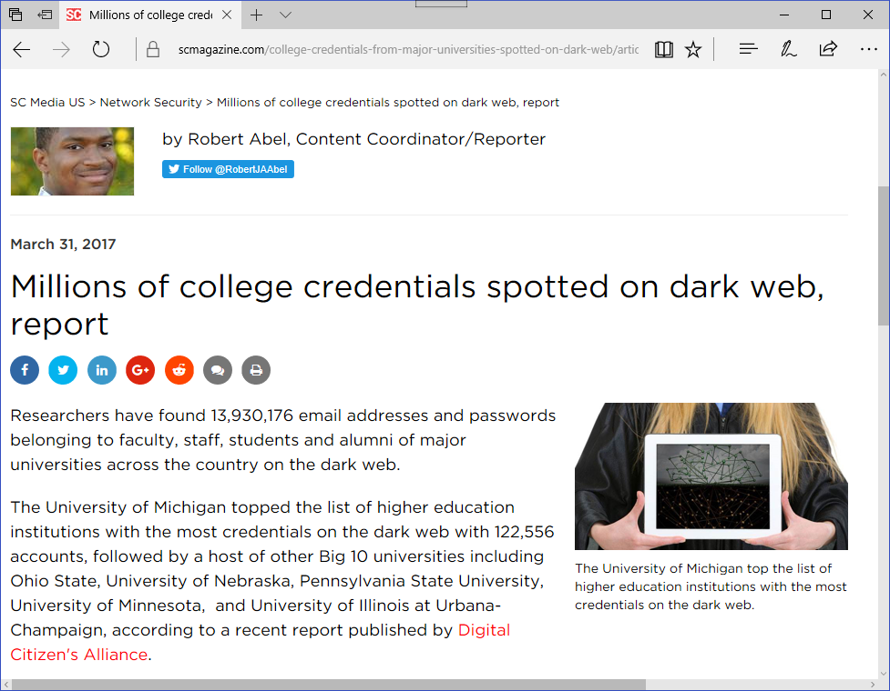
It’s getting rough out there…

Slide 6
It’s getting rough out there…

Slide 7
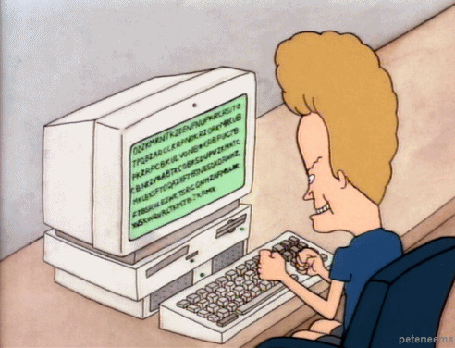
It’s getting rough out there…

Slide 8
CORPORATE vs. ACADEMIC computing environments
SPIFFCO BANK
Member FDIC
FUNKYTOWN COMMUNITY COLLEGE

Slide 9
Meet my smart uncle…

Slide 10
Meet my smart uncle…

Slide 11
Meet my smart uncle…

Slide 12
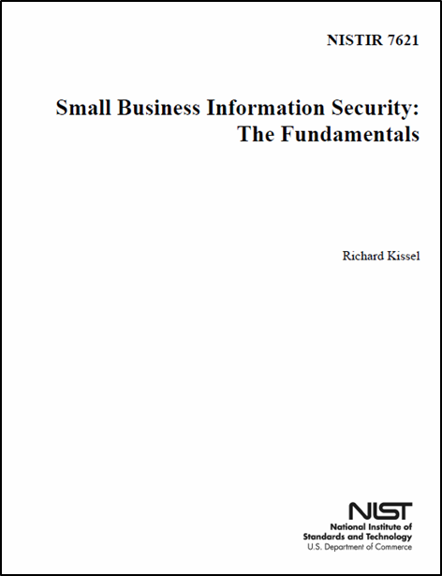
Meet my smart uncle…

Slide 13
Ten essential cyber security practices
1. Protect information/systems/networks from damage by viruses, spyware, ransomware, and other malicious code

Slide 14
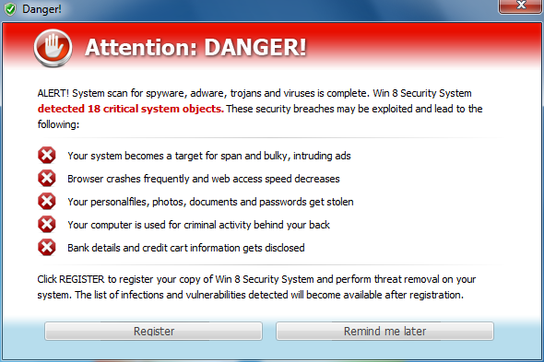
Ten essential cyber security practices
1. Protect information/systems/networks from damage by viruses, spyware, ransomware, and other malicious code
But beware of FAKE
anti-malware products…

Slide 15
Ten essential cyber security practices
2. Provide security for your connection to the Internet

Slide 16
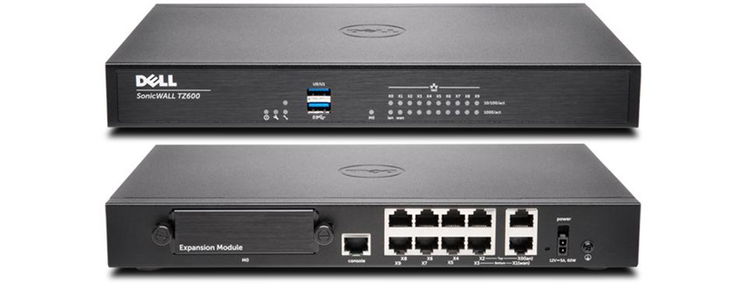
Ten essential cyber security practices
2. Provide security for your connection to the Internet
This usually means firewalls,
often in conjunction with IDS/IPS

Slide 17
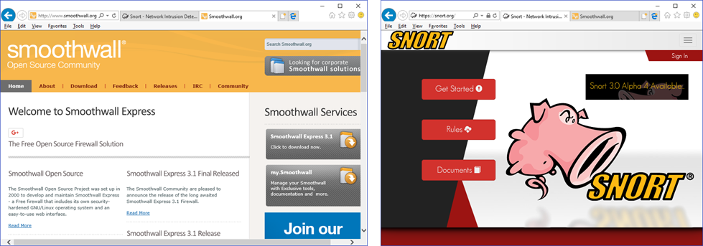
Ten essential cyber security practices
2. Provide security for your connection to the Internet
My cheapskate solution…
This usually means firewalls,
often in conjunction with IDS/IPS

Slide 18
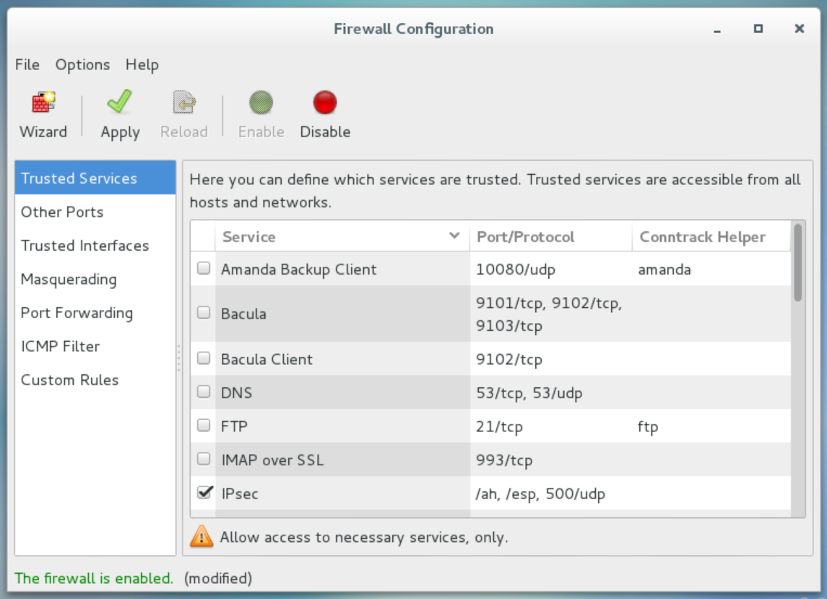
Ten essential cyber security practices
3. Install and activate software firewalls on all of your classroom computers and faculty/staff workstations

Slide 19
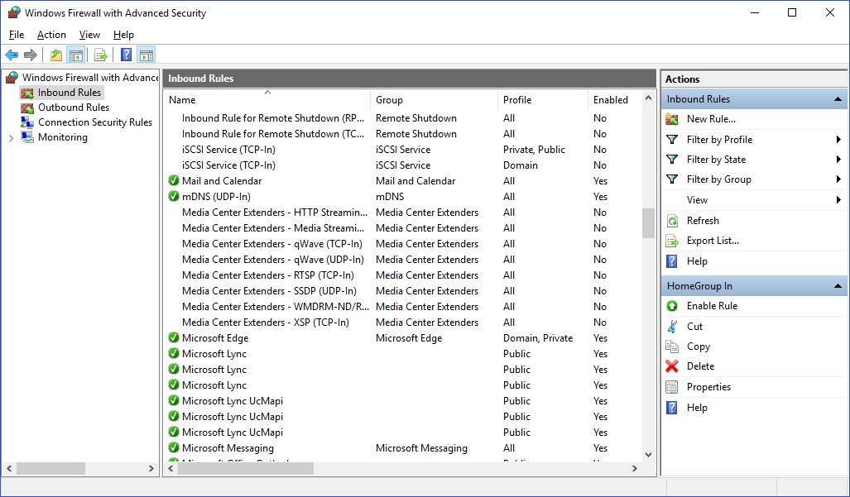
Ten essential cyber security practices
3. Install and activate software firewalls on all of your classroom computers and faculty/staff workstations

Slide 20
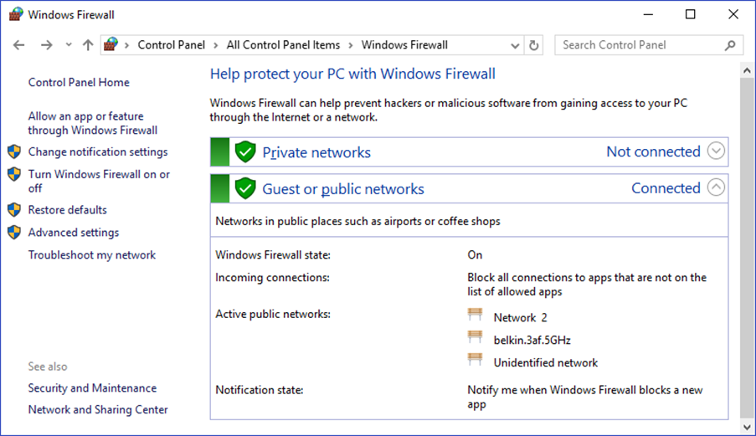
Ten essential cyber security practices
3. Install and activate software firewalls on all of your classroom computers and faculty/staff workstations
DANGER!

Slide 21
Ten essential cyber security practices
4. Patch your operating systems and applications

Slide 22
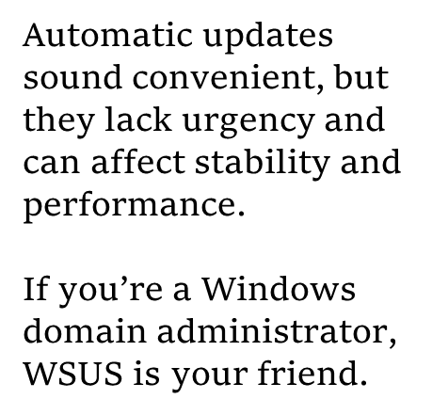
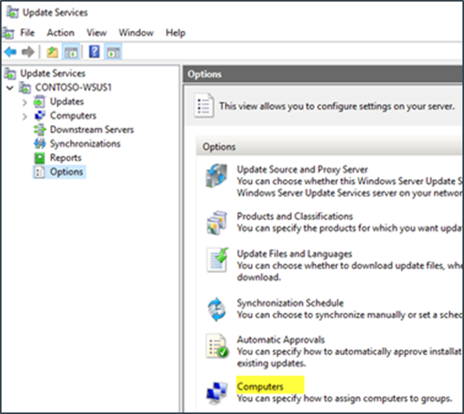
Ten essential cyber security practices
4. Patch your operating systems and applications

Slide 23
Ten essential cyber security practices
5. Make backup copies of important data

Slide 24
Ten essential cyber security practices
6. Control physical access to computers and network components

Slide 25
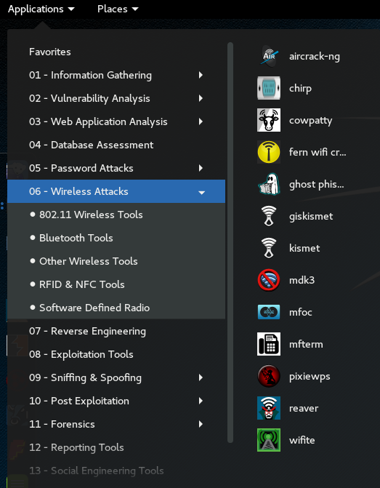
Ten essential cyber security practices
7. Secure your wireless access points and wireless networks
Wi-Fi hacking tools are plentiful and cheap (often free)
Malicious hackers and script kiddies have the advantage when you use weak encryption.
Avoid old and busted WEP - Wired Equivalent Privacy

Slide 26
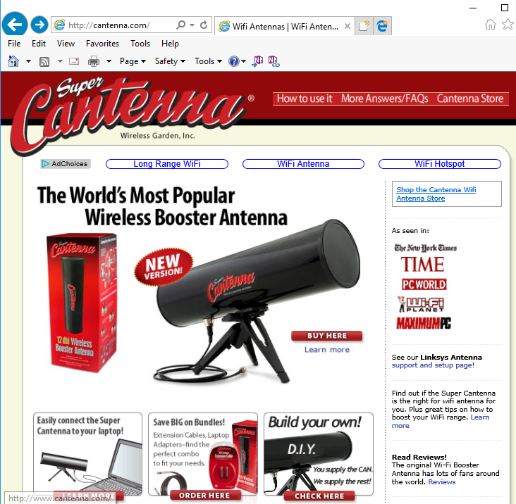
Ten essential cyber security practices
7. Secure your wireless access points and wireless networks

Slide 27
Ten essential cyber security practices
7. Secure your wireless access points and wireless networks
Accurate assessment of WEP encryption strength

Slide 28
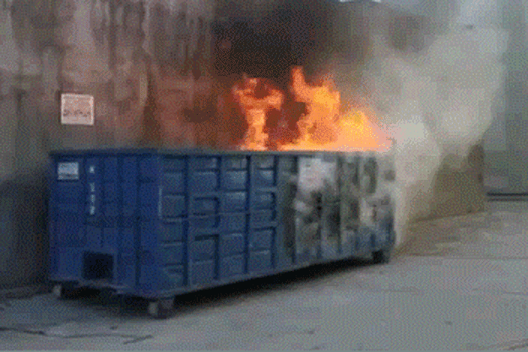
Ten essential cyber security practices
7. Secure your wireless access points and wireless networks
Accurate assessment of WEP encryption strength

Slide 29
Ten essential cyber security practices
8. Train students/faculty/staff in basic security principles

Slide 30
Ten essential cyber security practices
9. Require individual user accounts (with good passwords) for all students/faculty/staff

Slide 31
Ten essential cyber security practices
9. Require individual user accounts (with good passwords) for all students/faculty/staff
Classic approach:
COMPLEX PASSWORDS
Uppercase, lowercase, numerals, punctuation marks, etc.

Slide 32
Ten essential cyber security practices
9. Require individual user accounts (with good passwords) for all students/faculty/staff
Classic approach:
COMPLEX PASSWORDS
Uppercase, lowercase, numerals, punctuation marks, etc.
HelloKitty

Slide 33
Ten essential cyber security practices
9. Require individual user accounts (with good passwords) for all students/faculty/staff
Classic approach:
COMPLEX PASSWORDS
Uppercase, lowercase, numerals, punctuation marks, etc.
HelloKitty
H3ll0Kitty

Slide 34
Ten essential cyber security practices
9. Require individual user accounts (with good passwords) for all students/faculty/staff
Classic approach:
COMPLEX PASSWORDS
Uppercase, lowercase, numerals, punctuation marks, etc.
HelloKitty
H3ll0Kitty
H3ll0Kitty!

Slide 35
Ten essential cyber security practices
9. Require individual user accounts (with good passwords) for all students/faculty/staff
Classic approach:
COMPLEX PASSWORDS
Uppercase, lowercase, numerals, punctuation marks, etc.
HelloKitty
H3ll0Kitty
H3ll0Kitty!

Slide 36
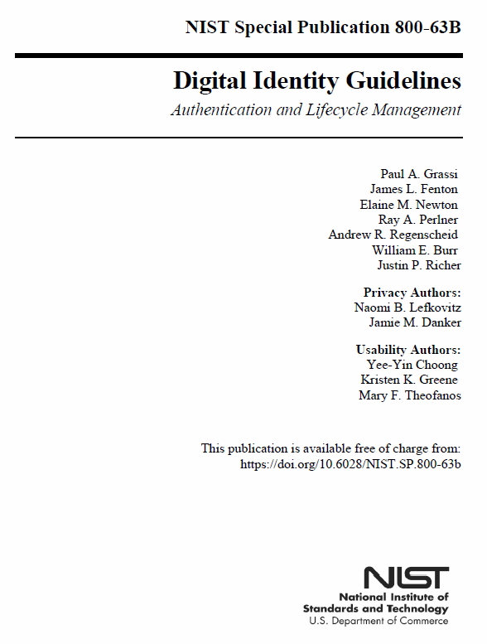
Ten essential cyber security practices
9. Require individual user accounts (with good passwords) for all students/faculty/staff
Password length has been found to be a primary factor in characterizing password strength.
Users should be encouraged to make their passwords as lengthy as they want, within reason.
- NIST SP 800-63B

Slide 37
Ten essential cyber security practices
10. Limit unauthorized access to data and information, and limit authority to install software

Slide 38
Five important questions
Do we know what is connected to our systems and networks?

Slide 39
Five important questions
Do we know what is connected to our systems and networks?
Do we know what software is running (or trying to run) on our systems and networks?

Slide 40
Five important questions
Do we know what is connected to our systems and networks?
Do we know what software is running (or trying to run) on our systems and networks?
Are we continuously managing our systems using “known good” configurations?

Slide 41
Five important questions
Do we know what is connected to our systems and networks?
Do we know what software is running (or trying to run) on our systems and networks?
Are we continuously managing our systems using “known good” configurations?
Are we continuously looking for and managing “known bad” software?

Slide 42
Five important questions
Do we know what is connected to our systems and networks?
Do we know what software is running (or trying to run) on our systems and networks?
Are we continuously managing our systems using “known good” configurations?
Are we continuously looking for and managing “known bad” software?
Do we limit and track the people who have the administrative privileges to change, bypass, or override our security settings?

Slide 43
Five important questions
Do we know what is connected to our systems and networks?
Do we know what software is running (or trying to run) on our systems and networks?
Are we continuously managing our systems using “known good” configurations?
Are we continuously looking for and managing “known bad” software?
Do we limit and track the people who have the administrative privileges to change, bypass, or override our security settings?
Source: The National Campaign for Cyber Hygiene

Slide 44
THANKS FOR YOUR TIME AND ATTENTION! Dennis.Thibodeaux@NewHorizons.com @Dennis_CFE

