Slide 1
Taking the Virtual Classroom to the Next Level Karen Hyder, CTT+

Slide 2
To prepare to join Adobe Connect session
If you have a laptop, you can log into Adobe Connect and participate.
First, run the system self test: https://na1cps.adobeconnect.com/common/help/en/support/meeting_test.htm
If you have a smart device, you can install and run Adobe Connect app.
Android Play Store https://play.google.com/store/apps/details?id=air.com.adobe.connectpro&hl=en
iTunes https://itunes.apple.com/us/app/adobe-connect-mobile/id430437503?mt=8
To participate in a virtual classroom, login here:
Your session room url + /?lightning=true
Select Guest and type in your own name. Click the Enter room button.
You can ask questions and interact in the session room by typing in chat and responding to polls.

Slide 3
To join Adobe Connect session
To participate in a virtual classroom
Your session room url + /?lightning=true
Select Guest and type in your own name. Click the Enter room button.
You can ask questions and interact in the session room by typing in chat and responding to polls.
Notes:
Add the URL to your session room.
Send or post this text for participants.
Add ?lightning=true to force open a new browser window which will provide more display space for the session room interface.

Slide 4
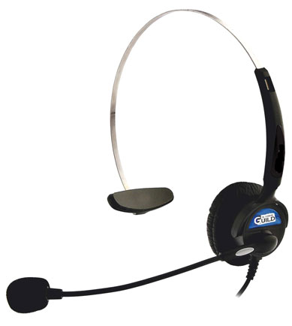
Use a good quality connection
To improve the quality of your audio and video for this webinar:
Use a wired Internet connection, rather than wireless
Close any applications you do not need on your computer
Use a PC headset if you have one.
Poor connection? Use telephone options instead.
Notes:
A good quality connection makes for a good webinar. To improve the quality of your audio and video for this webinar, try to use a wired, not wireless connection, and close any browsers or programs you are not using at the moment. If you have technical issues, type to me in chat and we will work on getting them corrected.
We’ve taken steps to ensure the audio is clear and consistent and we would like to ask you to make local adjustments on your machine to be sure you can hear well.

Slide 5
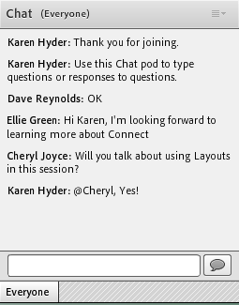
Type questions and comments into Chat
Type your question or response here
Click Send or press Enter
Notes:
We’ve designed the session to be interactive, so it’s important that you participate by typing in Chat. This is how you type your question or response, and then click send or press enter.

Slide 6
Set status to provide feedback
To show the menu, click the drop down arrow next to the raised hand button at the top of your screen.
If you are finding it, please change your status to Agree.
Provide feedback by setting your status
Notes:
The trainers might ask you to participate today by changing your status. You can change your status by clicking on the drop down menu next to the raised hand icon in the bar at the top of your screen.

Slide 7
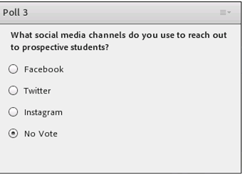
Respond to polls
Make your selection by clicking to the left of your response
Notes:
When asked to participate in a poll, you can simply click on the answer or answers that you wish to choose.

Slide 8
On Break
Click Step in and Show Agree when you’re ready to begin again.
Please change your status to Stepped away.
Type comments or questions in the Chat Pod.
Notes:
Scheduled breaks allow you can deal with urgent issues, visit the restroom, eat, refill your coffee, and stretch and move around. It’s ok to hang up the phone and redial, or you can just MUTE your mic and set the phone down while you take a break.
Come back a few minutes early to be sure you’re still connected, headset on, mic positioned, and you’re ready to go. If there’s time, read and respond to chat messages. I like to read and respond by typing and make overarching remarks when begin the session again. I can tie up loose ends from the previous section and engage learners as they are returning to the session and getting settled.
Always keep your session URL handy in case you get disconnected or accidentally close the room and need to rejoin. Print the dial in number and passcode in case the software is locked up and you cannot see the on-screen instructions.

Slide 9
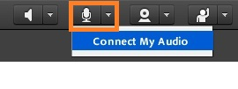
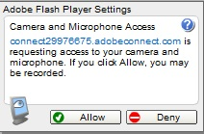
Set up your PC/ VoIP audio
1. Ideally, use a PC headset with a microphone. Built in mics and speakers are noisy!
2. Click the Connect My Audio (mic) button and select Connect my Audio.
3. Click Allow
4. To mute/unmute,
click the microphone icon.
Notes:
Show this slide as Participants are joining the session. Encourage them to speak up to test mics and then MUTE when not talking.

Slide 10
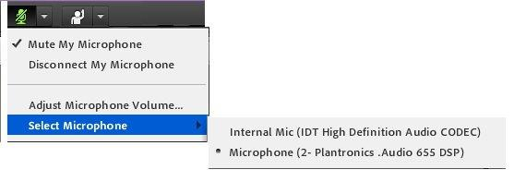
Select the correct VoIP mic/headset hardware
1. Please plug in your headset BEFORE you join the meeting.
2. Choose the hardware you prefer to use. If yours is not shown, please logout, plug in the hardware and rejoin the session.

Slide 11
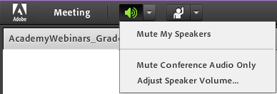
Not hearing?
Use your speaker button and menu to make adjustments
Or adjust the audio settings on your computer

Slide 12
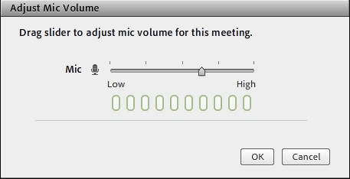
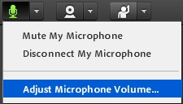
Not being heard?
Choose Adjust microphone volume menu.
Move slider left or right as you speak.

Slide 13
Questions and Reminders
Call or text _____for help before or during the session: +001 (000) 000-0000

Slide 14
Join the Audio Conference: Voice over IP (VoIP), or audio via the Internet
Choose Using Microphone if you want to have audio come through your headset (or speakers) instead of a telephone.
Do not choose this option if:
you don’t have a microphone.
you’re on a slow internet connection.
This option is called Voice over IP (VoIP), or audio via the Internet
Notes:
When dial in is an option, use these 3 slides as participants join

Slide 15
Join the Audio Conference: Have the session call your phone.
Choose Dial-out to have the conference calling service call you.
Direct lines only
No corporate or hotel ext. numbers
Use this option only if you are on a terrible internet connection or do not have PC speakers or headset and mic.
Otherwise, use computer audio (VoIP).
Click Dial in to display a list of dial in numbers and codes
Notes:
When dial in is an option, use these 3 slides as participants join

Slide 16
Join the Audio Conference: Dial in from your phone
Choose Dial-in:
if you do not know your phone number
or are using an number + extension
AND you are using a terrible internet connection
or do not have PC speakers or headset and mic.
Otherwise, use computer audio (VoIP).
Notes:
When dial in is an option, use these 3 slides as participants join

Slide 17
Login to play along in Adobe Connect
If you have a laptop, you can log into Adobe Connect and participate.
First, run the system self test: https://na1cps.adobeconnect.com/common/help/en/support/meeting_test.htm
If you have a smart device, you can install and run Adobe Connect app.
Android Play Store https://play.google.com/store/apps/details?id=air.com.adobe.connectpro&hl=en
iTunes https://itunes.apple.com/us/app/adobe-connect-mobile/id430437503?mt=8
You can ask questions and interact in the session room by typing in chat and responding to polls.
To participate in a virtual classroom, login here:
https://sitka-bay-co.adobeconnect.com/comptia/?lightning=true
Select Guest and type in your own name. Click the Enter room button.

Slide 18
Type in Chat
3. Explore Pod Options
Type questions and responses
2. Click Send or press Enter
Notes:
This is the first thing people are invited to do when they join.

Slide 19
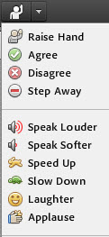
Change your Status
Click the Set Status menu
Click Agree or Disagree
An icon will display next to your name in the Attendees List
Notes:
This is the first thing people are invited to do when they join.

Slide 20
Taking the Virtual Classroom to the Next Level
Teaching CompTIA certification in a virtual classroom environment is more than a lecture with uploaded PowerPoint slides. Live virtual sessions leverage the engagement tools in the software and compel learners to participate throughout the learning event. Attend this session to learn how to rock your virtual classroom courses. You’ll get a toolkit of resources and a strategy to get the job done whether you teach virtually or in the classroom.
Notes:
Photo of chalk
Don’t blame the resources. People have done amazing things with less!

Slide 21
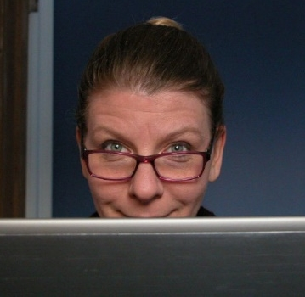
Karen Hyder, CTT+
karen@karenhyder.com
www.linkedin.com/in/karenhyder
Twitter @karenhyder
English language teacher | ‘88-‘93
Application software trainer | ‘91-‘96
Classroom train-the-trainer trainer | ‘95-‘99
Online train-the-trainer course designer and trainer | ’99-‘17
Advisor for CompTIA’s Certified Technical Trainer CTT+ | ‘01-‘17
Online event producer, coach, trainer | ‘99-‘17
Producer for The eLearning Guild Online Forums http://bit.ly/XCQVKJ | ‘03-‘15
The eLearning Guild Spotlight and Showcase events http://bit.ly/2bRhc9J | ‘09-‘17
Co-wrote The eLG’s Handbook on Synchronous e-Learning http://bit.ly/Y6Z760 | ‘07
Development of CompTIA’s Certified Technical Trainer CTT+ VCT certification http://bit.ly/kNXwIa | ‘08
Guild Academy Virtual classroom courses | ‘13-‘15
Blog https://karenhyderblog.wordpress.com | ‘14-’17
CompTIA’s CTT+ 8-week Deep Dive https://app.box.com/v/DeepDiveCTTplus | ’16
The eLearning Guild’s Guild Master | ‘17
Notes:
As you know, I’m Karen Hyder. I’m your trainer and host for this virtual classroom program. My background is in training. In one form or another, it’s what I’ve always done. I started out as an English teacher for non-native, adult students and later became a computer software trainer and then taught others to be trainers. Then, I developed a course to teach people to teach online using a tool called Placeware, which later became Microsoft Live Meeting.
I was instrumental in creating a certification for online trainers through CompTIA. Their 12 competencies provide a benchmark for good training online or in a face-to-face classroom.
What I’ve done is distilled what I’ve learned through all of these experiences to teach you and guide you as you adopt these new tools. It’s possible that I’ll ask you to do things that sound strange. I’m going to ask you to play along.

Slide 22
Poll 0: Agree to participate?
Contribute to the discussion by:
typing in Chat
responding to Polls
Setting Status
Type questions in Chat or hold until the end
Please resist distractions, but it’s OK to Tweet/Post
#CompTIA
#PartnerSummit17
@karenhyder
OK to excuse yourself for calls or personal time. Set status to Stepped Away.

Slide 23
Poll: What’s your experience teaching in a virtual classroom?
Lots. I teach online most of the time.
Some. I’ve just started.
Not a lot.
None. I only teach in a physical classroom.
None, but I’ve been a participant before.

Slide 24
Poll: How’s it going?
Great! I love it!
It’s ok, but I struggle.
I miss teaching face to face.
I love teaching in the classroom, but I have to start teaching online.
As a participant, I can learn either way as long as I have a good trainer.

Slide 25
“See” you online
Notes:
Why do you do it? Because of geographic dispersion.
But there’s so much more that we get from live training. It shouldn’t matter if it’s in person or online.
We’re already losing our learners to internet-based training.
Next: From Getting Started with Synchronous eLearning by Patti Shank

Slide 26
Why do live training at all?
?
Please type in Chat or shout out
Notes:
We’re losing our learners to internet-based training, But asynchronous eLearning is a reasonable way to go. You’ve watched videos, you’ve clicked through eLearning interactions—why do live training?
Please recognize that LIVE it’s not right for everything. The research showed that people thought virtual classroom training worked very well in these situations. Which are mostly the same reasons we use face to face training. If these are not important to your learning, that you might want to reconsider your approach.
From Getting Started with Synchronous eLearning by Patti Shank

Slide 27
Why do live training at all?
“Because of its attributes, synchronous eLearning works especially well:
To build motivation and excitement
When it makes sense to set aside a specific time to learn
When live support is needed
When there is value in learning from others
To process learners’ own situations
For “connecting” with people
When a quick response is needed
To allow geographically dispersed learners to interact”
−Patti Shank
The eLearning Guild Research Report. June, 2010.
Notes:
We’re losing our learners to internet-based training, But asynchronous eLearning is a reasonable way to go. You’ve watched videos, you’ve clicked through eLearning interactions—why do live training?
Please recognize that LIVE it’s not right for everything. The research showed that people thought virtual classroom training worked very well in these situations. Which are mostly the same reasons we use face to face training. If these are not important to your learning, that you might want to reconsider your approach.
From Getting Started with Synchronous eLearning by Patti Shank

Slide 28
Poll: Why do LIVE (a.k.a. synchronous) training at all?
“Because of its attributes, synchronous eLearning works especially well:
To build motivation and excitement
When it makes sense to set aside a specific time to learn
When live support is needed
When there is value in learning from others
To process learners’ own situations
For “connecting” with people
When a quick response is needed
To allow geographically dispersed learners to interact”
−Patti Shank
The eLearning Guild Research Report. June, 2010.
?
Please respond to the Poll
Notes:
If you’re weighing the pros and cons…
Also recognize that it’s not right for everything. The research showed that people thought virtual classroom training worked very well in these situations. Which are mostly the same reasons we use face to face training. If these are not important to your learning, that you might want to reconsider your approach.
From Getting Started with Synchronous eLearning by Patti Shank

Slide 29
CompTIA Certified Technical Trainer (CTT+) Domains and Competencies
Domain 1: Planning Prior to the Course
1A: Review Learning Objectives and Match Them to Learner and Organizational Needs
1B: Create an Environment Conducive to Learning
Domain 2: Methods and Media for Instructional Delivery
2A: Select and Implement Delivery Methods
2B: Use Instructional Media
Domain 3: Instructor Credibility and Communications
3A: Demonstrate Professional Conduct and Content Expertise
3B: Use Communication and Presentation Skills to Facilitate Learning
Domain 4: Group Facilitation
4A: Establish and Maintain a Learner-Centered Environment
4B: Use a Variety Question Types and Techniques
4C: Address Learner Needs for Additional Explanation and Encouragement
4D: Motivate and Reinforce Learners
Domain 5: Evaluate the Training Event
5A: Evaluate Learner Performance throughout the Training Event
5B: Evaluate Trainer Performance and Delivery of Course
https://partners.comptia.org/docs/default-source/resources/comptia-ctt-overview.pdf https://partners.comptia.org/docs/default-source/resources/comptia-ctt-virtual-classroom-trainer-how-to-prepare.pdf
https://partners.comptia.org/resources/download-central?q=CTT or https://www.comptia.jp/pdf/cttplus_objectives.pdf
Notes:
If you’re motivated by creating engagement and helping learners learn.
Blueprints for your role.

Slide 30
CompTIA Certified Technical Trainer (CTT+) Domains and Competencies
Domain 1: Planning Prior to the Course
1A: Review Learning Objectives and Match Them to Learner and Organizational Needs
1B: Create an Environment Conducive to Learning
Domain 2: Methods and Media for Instructional Delivery
2A: Select and Implement Delivery Methods
2B: Use Instructional Media
Domain 3: Instructor Credibility and Communications
3A: Demonstrate Professional Conduct and Content Expertise
3B: Use Communication and Presentation Skills to Facilitate Learning
Domain 4: Group Facilitation
4A: Establish and Maintain a Learner-Centered Environment
4B: Use a Variety Question Types and Techniques
4C: Address Learner Needs for Additional Explanation and Encouragement
4D: Motivate and Reinforce Learners
Domain 5: Evaluate the Training Event
5A: Evaluate Learner Performance throughout the Training Event
5B: Evaluate Trainer Performance and Delivery of Course
Notes:
Let’s look at a few of the competencies

Slide 31
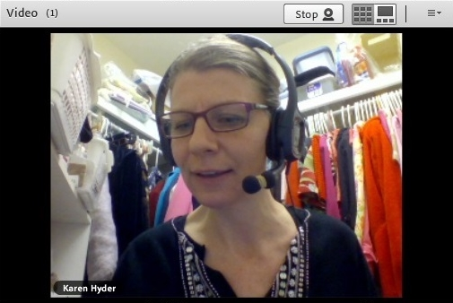
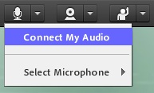
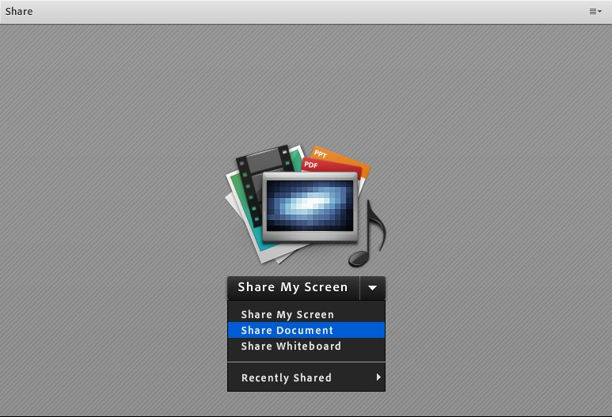
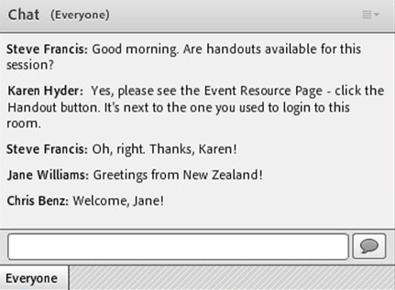
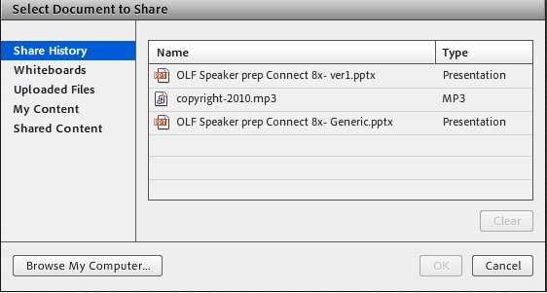
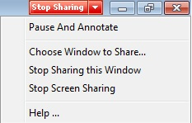
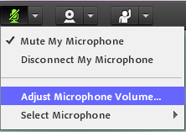
It’s a lot to manage BEFORE you even begin
© 2012-17 Karen Hyder
Notes:
Absolutely everything you’re used to is different. Where you might be used to writing on a whiteboard with a dry erase marker, you’re faced with a button representing a marker. Your dexterity with that marker is weak.
You like participation, but verbal responses take a lot of time.
While virtual classrooms aren’t rocket science, some aspects can feel overwhelming to a trainer who is trying to stay focused on her message. A distraction as small as one student says he can’t see the slide can derail the training for several minutes and throw a trainer off.
Simply moving from one virtual classroom software interface to a different one is challenging. Things don’t work quite the same way. Here, the microphone is off by default- there, it on. Some tools let you upload files, others only support live application sharing.

Slide 32
Presenter
P 1B: Create an Environment Conducive to Learning
Each Facilitator needs:
System setup
Internet connection
Headset with microphone
to remember to Mute own mic whenever not speaking.
Mute ringers and muzzle dogs
Practice!
Notes:
If you’re realistic about what it takes to produce a webinar and you plan out how you will deal with each of these areas, you’re off to a great start.
Think of your trainers and learners, think of the technology, think of the lesson activities and materials. Each piece is crucial.
You’ll want to create checklists to be sure all details are handled. Missing something as simple as how audio will be supported can be disastrous.

Slide 33
Presenter
P 1B: Create an Environment Conducive to Learning
Each Facilitator needs:
System requirements-meeting computer with apps installed
a stable, wired Internet connection
Are you on a wireless, high-traffic or low-bandwidth connection?
Get to a place with wired connection
Shut down unneeded apps
Don’t VoIP. Dial in.
a decent-quality Headset with microphone
USB, plug in before joining
Or for Landline phone
to remember to Mute own mic whenever not speaking.
to silence alerts and distractions
Email/text
Phone or fax
Mobile devices
Dog, cat, bird, family, office mates, co-workers
Lawn and yard workers
Experience and practice using and managing the virtual classroom
Upload files, share, control audio, breakouts, polls,
Troubleshooting
Notes:
You can Say all these things, but better not to put this all on the slide.
Think of your trainers and learners, think of the technology, think of the lesson activities and materials. Each piece is crucial.
You’ll want to create checklists to be sure all details are handled. Missing something as simple as how audio will be supported can be disastrous.
System requirements-meeting computer with apps installed
a stable, wired Internet connection
Are you on a wireless, high-traffic or low-bandwidth connection?
Get to a place with wired connection
Shut down unneeded apps
Don’t VoIP. Dial in.
a decent-quality Headset with microphone
USB, plug in before joining
Or for Landline phone
to remember to Mute own mic whenever not speaking.
to silence alerts and distractions
Email/text
Phone or fax
Mobile devices
Dog, cat, bird, family, office mates, co-workers
Lawn and yard workers
Experience using and managing the virtual classroom
Upload files, share, control audio, breakouts, polls,
Troubleshooting

Slide 34
P 1B: Create an Environment Conducive to Learning
What does each Participant need:
Clear instructions in advance
Good Internet connection
PC headset OR Landline phone with headset
Hassle-free login and audio setup
Visual and audible instructions
Well-organized, easy-to-access, useful materials
Opportunities to engage throughout
What else might your participants need?
?
Please type in Chat or shout out

Slide 35
Presenter
P 2B: Use Instructional Media
Which is better:
A: Short, bulleted text
B: Entire script with key points
?
Please respond to the Poll
Notes:
If you’re realistic about what it takes to produce a webinar and you plan out how you will deal with each of these areas, you’re off to a great start.
Think of your trainers and learners, think of the technology, think of the lesson activities and materials. Each piece is crucial.
You’ll want to create checklists to be sure all details are handled. Missing something as simple as how audio will be supported can be disastrous.

Slide 36
Presenter
P 2A: Select and Implement Delivery Methods
Which is better:
A: Lecture
B: Open-ended chat question
?
Please respond to the Poll
Notes:
If you’re realistic about what it takes to produce a webinar and you plan out how you will deal with each of these areas, you’re off to a great start.
Think of your trainers and learners, think of the technology, think of the lesson activities and materials. Each piece is crucial.
You’ll want to create checklists to be sure all details are handled. Missing something as simple as how audio will be supported can be disastrous.

Slide 37
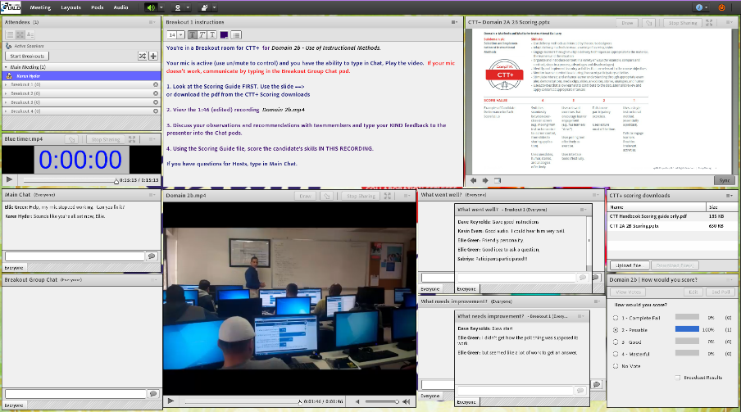
2B: Use Instructional Media
© 2012-17 Karen Hyder
©2016 Humberto Hilario humbertoh@pcage.edu

Slide 38
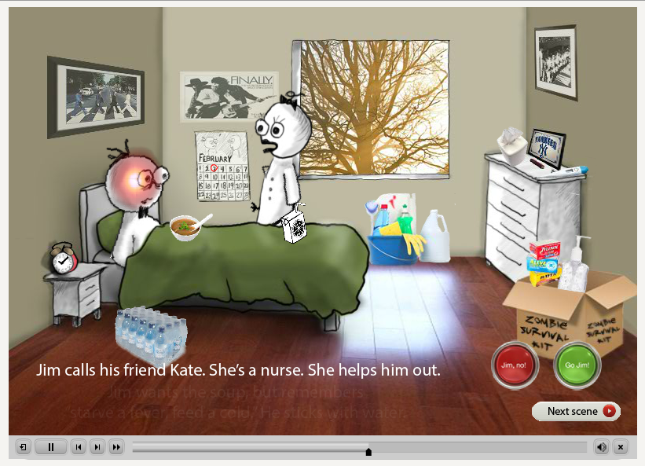
2B: Use Instructional Media
from Joe Ganci http://elearningjoe.com/
Created with Rutgers University for the State of New Jersey. Find entire piece here: www.getflusavvy.com
Notes:
My buddy Joe Ganci, Captivate trainer and guru and Guildmaster created this little lesson about recovering from the flu. Rutgers U. Getflusavvy.com

Slide 39
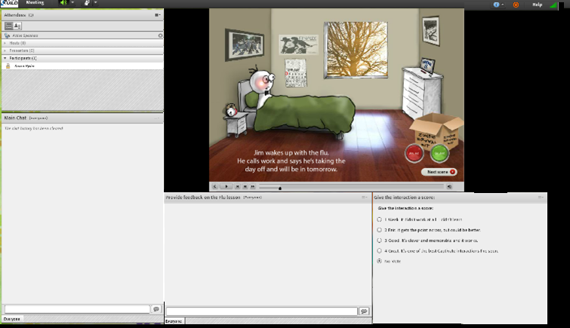
2B: Use Instructional Media
Notes:
https://elearningguild.adobeconnect.com/r51vonbf4ks/
Now that you’ve played with the interaction, I want to challenge you a bit. I teach people who to determine how to make things better.
Please do this activity to provide feedback to the creator. What score would you give it?

Slide 40
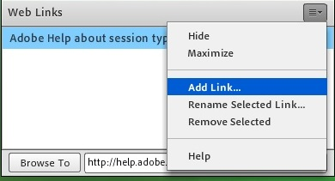
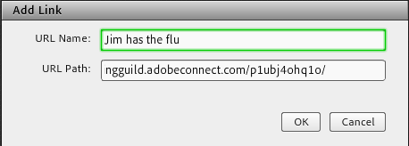
Force a browser and web page to all
Please stand by for browser window

Slide 41
Activity: Evaluate the interaction
Interact with the Captivate file “Jim has the flu.”
Use the Chat pods (below) to provide feedback to the interaction designer on the lesson.
Score the interaction using the Poll.
Set your Status to Thumbs up/Agree/Green check when done.
You have 3 minutes.
?
Please do activity
Notes:
Instructions to show in layout

Slide 42
3A: Demonstrate Professional Conduct and Content Expertise
Share 3 ways you’ve seen training professionals damage/destroy their own credibility:
?
Please type in Chat

Slide 43
3A: Demonstrate Professional Conduct and Content Expertise
Have you seen/heard training professionals (choose all that apply):
Arguing with participants
Swearing
Riffing
Starting late
Going over time
Not answering questions
Blaming others
Not achieving objectives
Pretend not to hear
Burping or chewing into the microphone
Lying
Bullying
Not admitting mistakes
Talking nonsense
Sharing too much information (T.M.I)
Sexual innuendo and/or misconduct
Talk about learners behind their backs
Worse!
?
Please respond to the Poll

Slide 44
3B: Use Communication and Presentation Skills to Facilitate Learning
Adjust your language and your tasks
If , in the physical classroom you say… | If , in Adobe Connect you say… | Then, in Adobe Connect use…
“Let me demonstrate…” | “You’ll see your display change as I start sharing my screen.” | Application Share anything running on your desktop
“Choose this or this…” | “Please respond to the poll you see on your screen.” | Show Poll pod
“Share an example of your own…” | “Please unmute your mic and describe your example.” | VoIP/ Telephone audio enabling all voices to be heard by all
“Let’s brainstorm…” | “Use the Chat pods I’m showing now to list the advantages and disadvantages.” | 2 Chat pods
“Explore this website on your own…” | “Click the posted link to access the site.” | Add Hypertext link to PPT slide or paste URL into Chat. Use Web Links pod to force open browser for each participant
© 2012-17 Karen Hyder
Notes:
More than knowing what NOT to say and DO, it’s important to know what to say and do.

Slide 45
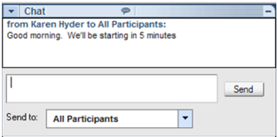
3B: Use Communication and Presentation Skills to Facilitate Learning
If , in the physical classroom you say… | If , in WebEx you say… | Then, in WebEx use…
“Let me demonstrate…” | “You’ll see your display change as I start sharing my screen.” | Application Share anything running on your desktop
“Share an example of your own…” | “Please unmute your mic and describe your example.” | VoIP/ Telephone audio enabling all voices to be heard by all
“Choose this or this…” | “Please respond to the poll you see on ….” | Show .atp file
“Let’s brainstorm…” | “Use….”
“Explore this website on your own…” | “….”
© 2012-17 Karen Hyder
In WebEx, how would you say it?
Notes:
You’re still dealing with teachers and students wanting to meet the same objectives. Only the TOOLS have changed.

Slide 46
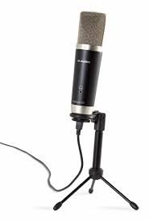
What other phrases do you find yourself saying online?
?
Please type in Chat

Slide 47
4A: Establish and Maintain a Learner-Centered Environment
Honestly, do you feel that we have co-created a learner-centered environment here?
What did I do to set up for it? How?
What have you been doing? Why?
?
Please type in chat or shout out
Notes:
Let me take a minute to read what you’ve been typing.
and to speak up.

Slide 48
4B: Use a Variety of Question Types and Techniques
What types of questions have you heard me ask?
What else did I do to improve the chance that you’d respond?
?
Please type in chat or shout out
Notes:
Let me take a minute to read what you’ve been typing.
and to speak up.

Slide 49
4C: Address Learner Needs for Additional Explanation and Encouragement
How does your participation help me help you?
?
Please type in chat or shout out
Notes:
Let me take a minute to read what you’ve been typing.
and to speak up.

Slide 50
4D: Motivate and Reinforce Learners
Am I leveraging the advantages of synchronous?
“Because of its attributes, synchronous eLearning works especially well:
To build motivation and excitement
When it makes sense to set aside a specific time to learn
When live support is needed
When there is value in learning from others
To process learners’ own situations
For “connecting” with people
When a quick response is needed
To allow geographically dispersed learners to interact”
−Patti Shank
The eLearning Guild Research Report. June, 2010.
?
Change Status to Agree or Disagree
Notes:
Let me take a minute to read what you’ve been typing.
and to speak up.

Slide 51
5A: Evaluate Learner Performance Throughout the Training Event
Your participation helps me SEE that you are getting it.
What tools can you use to Evaluate Learner Performance Throughout the Training Event?
What questions can you ask to Evaluate Learner Performance Throughout the Training Event?
?
Please type in chat or shout out
Notes:
Let me take a minute to read what you’ve been typing.
and to speak up.

Slide 52
5B: Evaluate Trainer Performance and Delivery of Course
Self reflect first:
What went well? What should I keep next time?
What didn’t go well? What do I need to change next time?
Then, consider the feedback from the participants:
Do their comments align with my own notes?
Do they have merit?
How might I follow up?
What should I consider before next time?
Notes:
Let me take a minute to read what you’ve been typing.
and to speak up.

Slide 53
What have you learned today that you can apply right away?
?
Please type in chat or shout out
Notes:
Let me take a minute to read what you’ve been typing.
and to speak up.

Slide 54
More from me on the topic of virtual classroom training
CompTIA CTT+ Deep Dive: https://app.box.com/v/DeepDiveCTTplus
Recordings of 8-week program focused on CTT+ Domains
Learning Leaders: Karen Hyder and Virtual Training's Evolution
https://www.learningsolutionsmag.com/articles/2386/learning-leaders-karen-hyder-and-virtual-trainings-evolution/pageall
The Learning Circle. Making the jump from traditional to virtual classroom.
https://media.dau.mil/media/EP015A+Karen+Hyder+on+The+Virtual+Classroom/1_sybyo0hz/71234322?lipi=urn:li:page:d_flagship3_detail_base;LDkjAkKfQjGnEp1aO0Sq4w==

Slide 55
Contact :
Email: karen@karenhyder.com
www.linkedin.com/in/karenhyder
Twitter: @karenhyder
Blog: https://karenhyderblog.wordpress.com/
Site: www.karenhyder.com

Slide 57
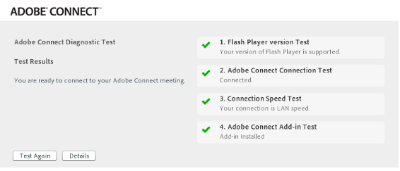
Did you run the Adobe Connect Diagnostic before this session?
Adobe Connect self test installs the Add-in and checks for system compatibility
Flash Player version test
Internet Connection test
Speed test
Add-in test
?
Change Status to Agree or Disagree

Slide 58
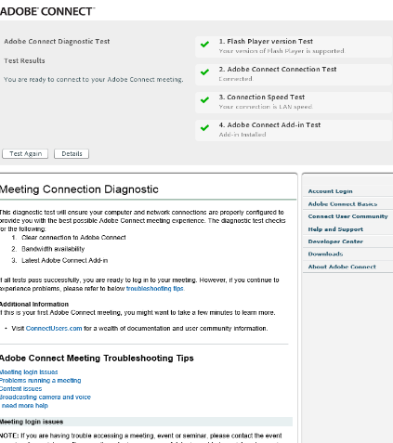
Everyone wins when participants run the diagnostic and install the Add-in BEFORE the day of the session
Adobe Connect Self test installs the Add-in and checks for system compatibility
http://admin.adobeconnect.com/common/help/en/support/meeting_test.htm
Why might this be helpful?
?
Type in Chat or shout out

Slide 59
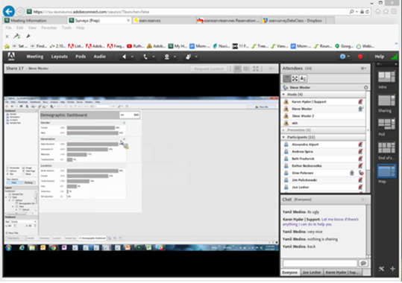
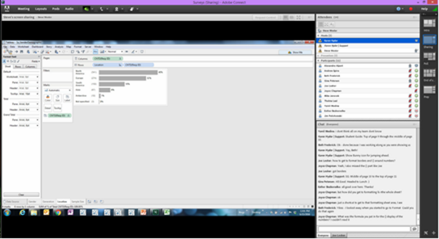
Poll: Which option is better?
Option A: Adobe Connect running in a browser tab
Option B: Adobe Connect running in a standalone window
© 2012-17 Karen Hyder
?
Please respond to the Poll
Notes:
http://connectwithabbas.blogspot.com/2011/09/lightningtrue-forcing-install-of.html One of the great things about Adobe Connect is that it just works. You invite someone into your meeting room, they click a link and join the meeting - no pop-ups, no downloads, no hassle. Of course, the secret sauce is the Flash Player which is installed on just about every desktop connected to the Internet. However, if you want all your participants to install the Adobe Connect Meeting Add-in to join your meeting (there are a few good reasons for this), you can do this by adding a ?lightning=true to the meeting room URL, e.g. http://my.adobeconnect.com/abbas?lightning=true. Participants simply agree to the lightning install download and that's it!
Posted by Abbas at 8:01pm

Slide 60
Because it installs the Add-in and forces the Adobe Connect session to open in a standalone window. Participants use a larger display area.
Option A is better
Option A: http://elearningguild.adobeconnect.com/classroom/?lightning=true
Option B: http://elearningguild.adobeconnect.com/classroom/

Slide 61
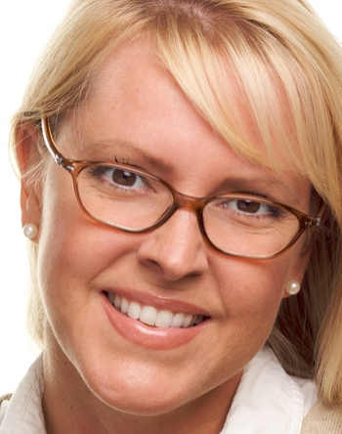
Adapting for Virtual Training | Redesign, Prep and Delivery Plan
Start
Agree to agree
Prep 1
Immersion, audio test. How to use and leverage virtual tools, Reframe
Note how features will impact lesson plan
Connect with trainer
Update files considering
virtual tools
Determine interactions, make adjustments to files and settings
Update files considering
Prep 2 decisions
Teach/ Rehearse tools from Host view
Identify plan B
Offer feedback. Demonstrate options. Reframe
Prep 2
Click through materials
Rehearse
Deliver successful session
End
Prep 3
Click through slides, test everything including Plan B. Agree on tasks. Rehearse?
FINALIZE
Event day
Login early. Final checks
Intro, tutorial and tech support
Thank yous and survey
Q & A
Close session. Debrief
Notes:
Coaching is iterative. It takes time for someone to look at what’s available, what they did before and how you propose they do it now. They need regular course correction so they don’t spend time on the wrong things. (can’t do breakouts in 60 min session.)
Look at Anna’s coaching plan as a flow chart.
An experienced in-person trainer, Anna is very knowledgeable on a catalog of topics, but is new to virtual online sessions.
Anna told co-workers that she doesn’t like that people don’t participate like they do face-to-face. Plus audio never works right!

Slide 62
Do you need a Producer? Can you manage everything by yourself?
What needs to happen? | Can you do it? | Quickly? | While still engaging learners?
Present a clear and focused presentation
Provide verbal software instructions to participants
Advance slides
Demonstrate Application
Display polls
Broadcast webcam image
Play media file
Control audio
Monitor chat
Organize participants into Breakout groups
Open Web Links pod and push activity page
Turn on Participants privileges
Transfer handout file
Identify open mics and mute them
Clear status indicators
Respond to technical or administrative questions
Keep track of time
© 2012-17 Karen Hyder
Notes:
Knowing how and being able to are different.
Trying to stay focused on your message, respond to questions.
The minute you’re distracted, you talk differently. Say things backwards or use the wrong word.

